Slide 1
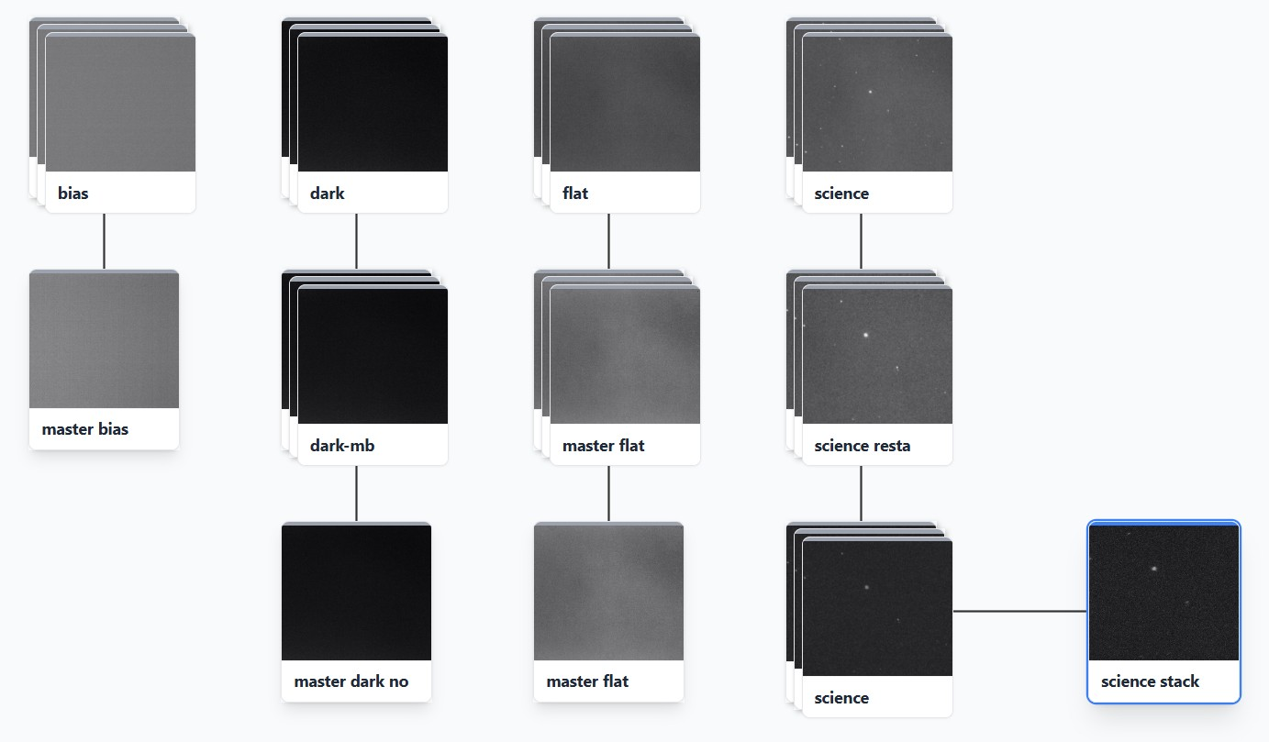


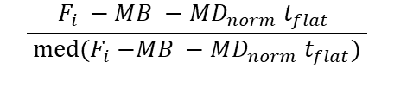










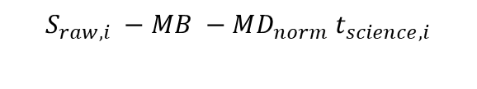
$$B_{i}$$
$$D_{i}$$
$$F_{i}$$
$$S_{raw,i}$$
med
$$\left(D_{i}−MB\right)$$
$${/t}_{Dark}$$
$$\frac{F_{i} −MB −MD_{norm} t_{flat} }{ med{(F}_{i} −MB −MD_{norm} t_{flat}) }$$
$$S_{raw,i} −MB −MD_{norm} t_{science,i}$$
$$MB$$
med
med
$÷MF t_{science,i}$
stacked
$$MD_{norm}$$
$$MF$$
$$S_{calib,i}$$
$$S_{stacked}$$

